Slide 1
AZURE MESSAGING SERVICES & AZURE MONITORING
MANOJ

Slide 2
Azure messaging services :
Messaging services on Azure provide the interconnectivity between components and applications that are written in different languages and hosted in the same cloud, multiple clouds, or on-premises.
Products for messaging services on Azure :
Service Bus
Event Grid
Event Hubs

Slide 3

Azure Service Bus :
Azure Service Bus is a fully managed enterprise message broker with message queues and publish-subscribe topics (in a namespace)
The service is intended for enterprise applications that require transactions, ordering, duplicate detection, and instantaneous consistency
Service Bus is used to decouple applications and services from each other

Slide 4
Service Bus has the following characteristics :
Reliable asynchronous message delivery (enterprise messaging as a service) that requires polling
Advanced messaging features like first-in and first-out (FIFO), batching/sessions, transactions, dead-lettering, temporal control, routing and filtering, and duplicate detection
At least once delivery of a message
Optional ordered delivery of messages

Slide 5
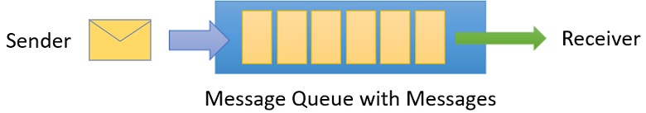
Queues :
Messages are sent to and received from queues. Queues store messages until the receiving application is available to receive and process them.
Messages in queues are ordered and timestamped on arrival. Once accepted by the broker, the message is always held durably in triple-redundant storage, spread across availability zones if the namespace is zone-enabled

Slide 6
Event :
An event is a lightweight notification of a condition or a state change.
The publisher of the event has no expectation about how the event is handled.
The consumer of the event decides what to do with the notification.
Events can be discrete units or part of a series.
Discrete events report state change and are actionable.

Slide 7
Message :
A message is raw data produced by a service to be consumed or stored elsewhere.
The message contains the data that triggered the message pipeline.
The publisher of the message has an expectation about how the consumer handles the message
A contract exists between the two sides.

Slide 8

2. Event Grid :
Event Grid is a highly scalable, serverless event broker that you can use to integrate applications using events
It uses the publish-subscribe model
Publishers emit events, but have no expectation about how the events are handled.
Subscribers decide on which events they want to handle.
Event Grid is deeply integrated with Azure services and can be integrated with third-party services.
It simplifies event consumption and lowers costs by eliminating the need for constant polling.

Slide 9
Azure Event Grid has the following characteristics:
Dynamically scalable
Low cost
Serverless
At least once delivery of an event

Slide 10

3. Event Hubs :
Azure Event Hubs is a big data streaming platform and event ingestion service
It can receive and process millions of events per second.
Data sent to an event hub can be transformed and stored by using any real-time analytics provider or batching/storage adapters.
It facilitates the capture, retention, and replay of telemetry and event stream data.

Slide 11
It's available either as data streams or bundled event batches.
This service provides a single solution that enables rapid data retrieval for real-time processing, and repeated replay of stored raw data.
It can capture the streaming data into a file for processing and analysis.
Event Hubs has the following characteristics:
Low latency
Can receive and process millions of events per second
At least once delivery of an event

Slide 12
AZURE MONITORING

Slide 13
Azure Monitor :
Azure Monitor helps you maximize the availability and performance of your applications and services.
It delivers a comprehensive solution for collecting, analyzing, and acting on telemetry from your cloud and on-premises environments.
This information helps you understand how your applications are performing and proactively identify issues that affect them and the resources they depend on.

Slide 14
Azure Monitor activity log :
The Azure Monitor activity log is a platform log in Azure that provides insight into subscription-level events.
The activity log includes information like when a resource is modified or a virtual machine is started.
It’s a place where you collect all the activities done by the admins
Ex: Creating V/M’s , Deleting V/M’s
You can view the activity log in the Azure portal
Activity log events are retained in Azure for 90 days and then deleted.

Slide 15
You can access the activity log from most menus in the Azure portal
If you open it from the Monitor menu, the only filter is on the subscription.
If you open it from a resource's menu, the filter is set to that resource.
You can always change the filter to view all other entries. Select Add Filter to add more properties to the filter.

Slide 16
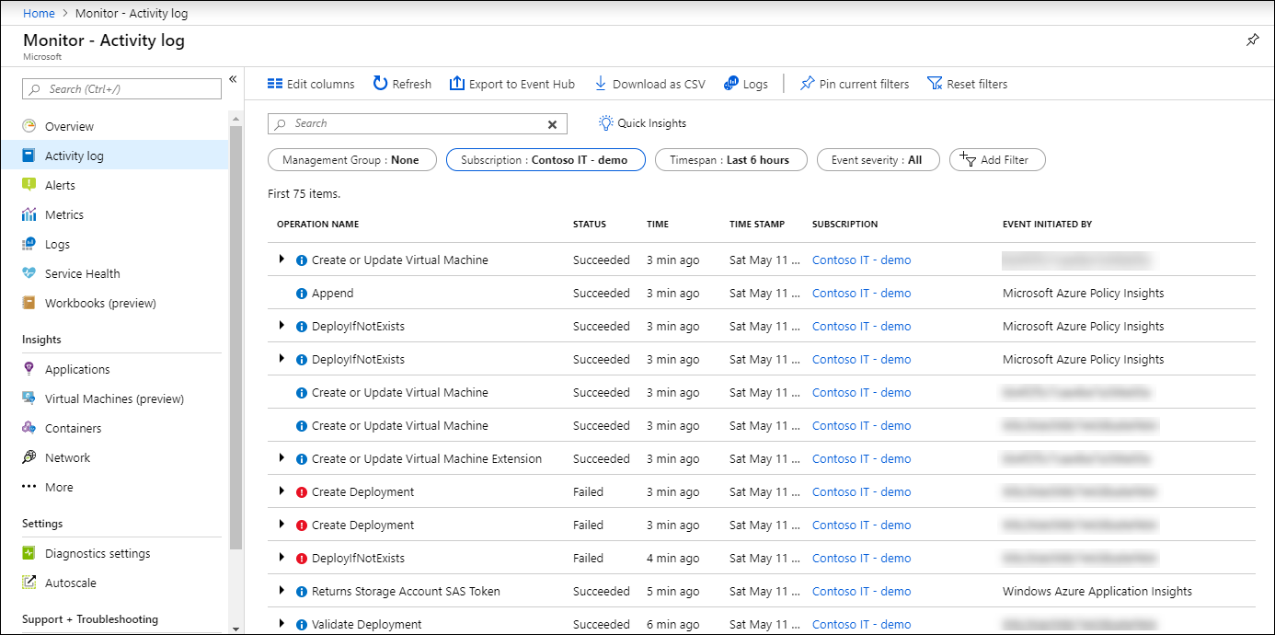

Slide 17
Azure monitor metrics :
Azure monitor metrics measure a resource’s characteristics over a certain period of time.
Metrics are numerical data that define properties like CPU usage, memory usage, network usage, etc.
These are real-time measurements stored in intervals and can be analysed using the metrics explorer.
They are ideally suitable to be visualised as graphs as they are stored in a time-series database.

Slide 18
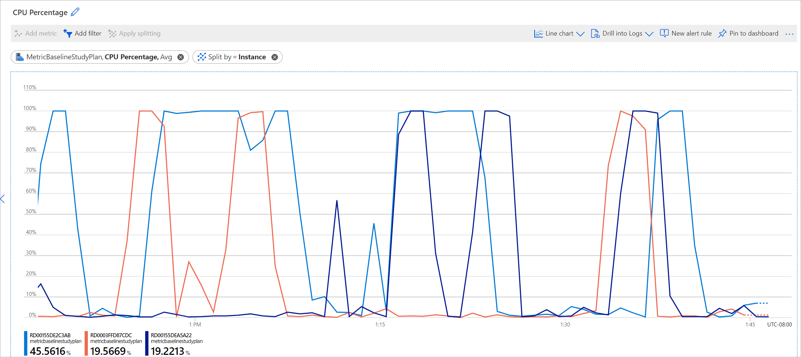

Slide 19
Azure Monitor Alerts :
Alerts help you detect and address issues before users notice them by proactively notifying you when Azure Monitor data indicates that there may be a problem with your infrastructure or application.
Alerts in Azure Monitor Alerts can notify about critical conditions and can start actions to solve the issue.
Alerts based on metrics give real-time notifications and based on logs can alert for complex logic between multiple sources.

Slide 20
An alert rule monitors your telemetry and captures a signal that indicates that something is happening on the specified resource.
The alert rule captures the signal and checks to see if the signal meets the criteria of the condition.
If the conditions are met, an alert is triggered, which initiates the associated action group and updates the state of the alert

Slide 21
An alert rule combines:
The resource(s) to be monitored
The signal or telemetry from the resource
Conditions
Azure Monitor has four types of alerts :
1.Metric alerts
2.Log alerts
3.Activity log alerts
4.Smart detection alerts

Slide 22
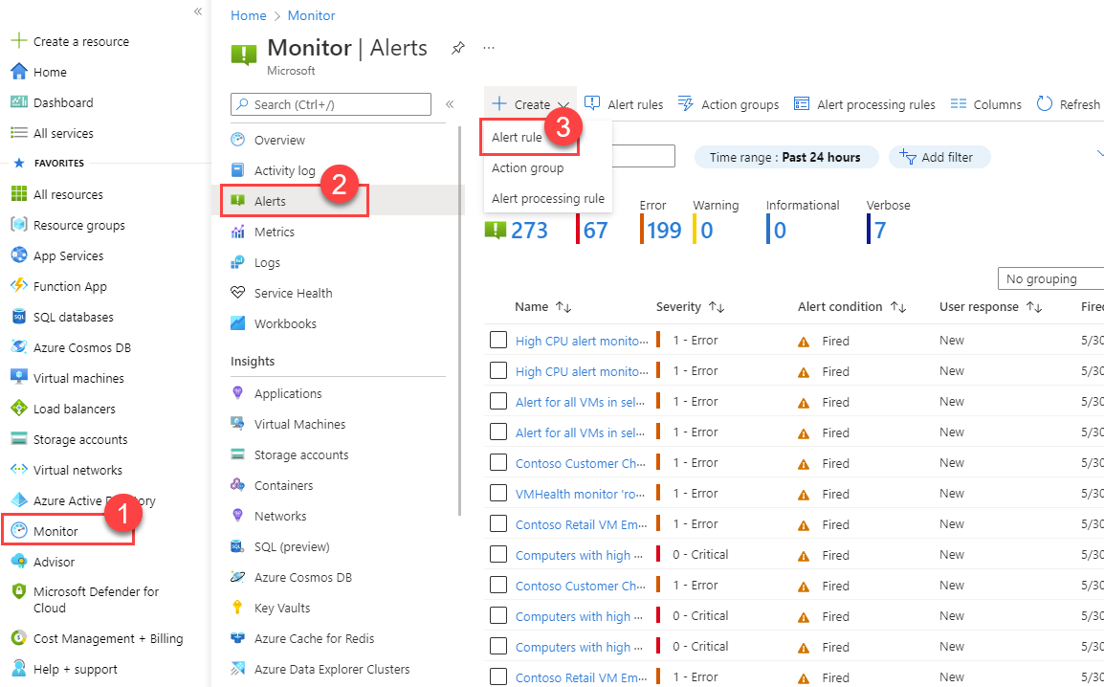

Slide 23
Application Insights :
The performance, availability, and usage of various web applications hosted in the cloud or on-premises can be monitored with Application Insights
Performance management system for our live applications like webapps
Live information from the website how many users are connected , How many users are spending this amount of time ,information.

Slide 24
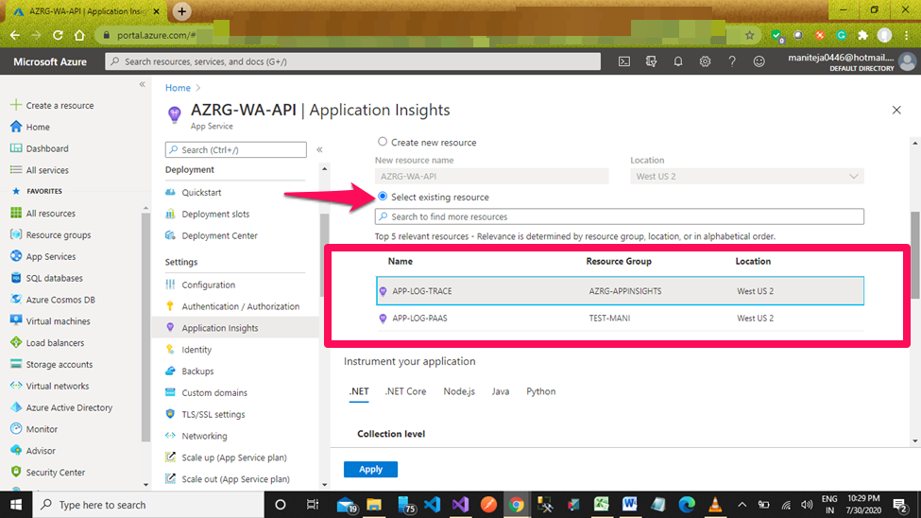

Slide 25
Azure Workbooks :
Workbooks provide a flexible canvas for data analysis and the creation of rich visual reports within the Azure portal.
They allow you to tap into multiple data sources from across Azure and combine them into unified interactive experiences.
Workbooks let you combine multiple kinds of visualizations and analyses, making them great for freeform exploration.

Slide 26
Workbooks are helpful for scenarios such as :
Exploring the usage of your virtual machine when you don't know the metrics of interest in advance. You can discover metrics for CPU utilization, disk space, memory, and network dependencies.
Explaining to your team how a recently provisioned VM is performing. You can show metrics for key counters and other log events.
Sharing the results of a resizing experiment of your VM with other members of your team. You can explain the goals for the experiment with text. Then you can show each usage metric and the analytics queries used to evaluate the experiment, along with clear call-outs for whether each metric was above or below target.
Reporting the impact of an outage on the usage of your VM. You can combine data, text explanation, and a discussion of next steps to prevent outages in the future.

Slide 27
